Slide 1
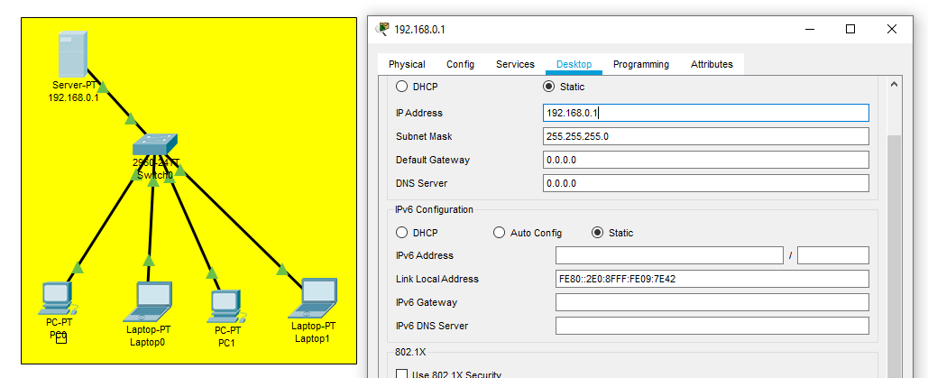
DHCP server config through server
After network creation select server give ip address ..

Slide 2
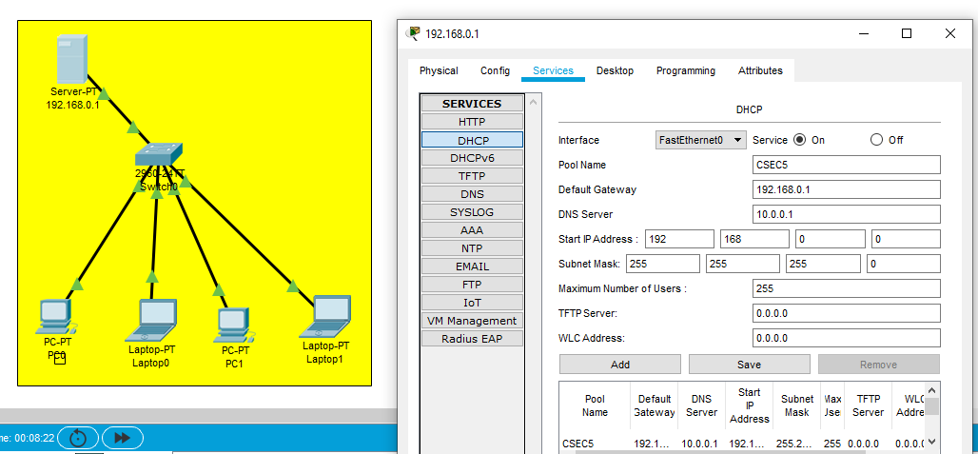
Now click on server services select DHCP ..put service on.. give pool name give default gateway and dns server ..then click on ADD

Slide 3
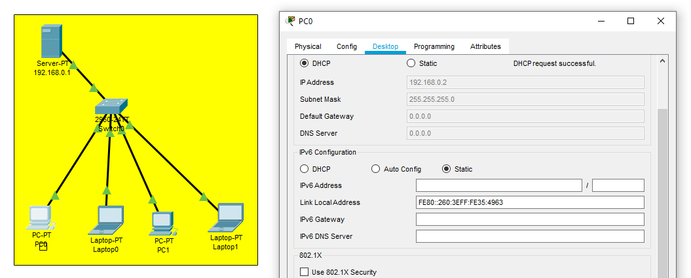
Go to any PC and click on DHCP you will get dynamic ip address to every PC on network..

Slide 4
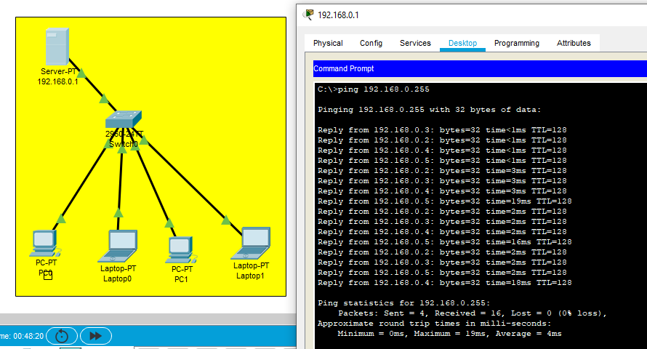
Now Ping from server 192.168.0.255

